Slide 3
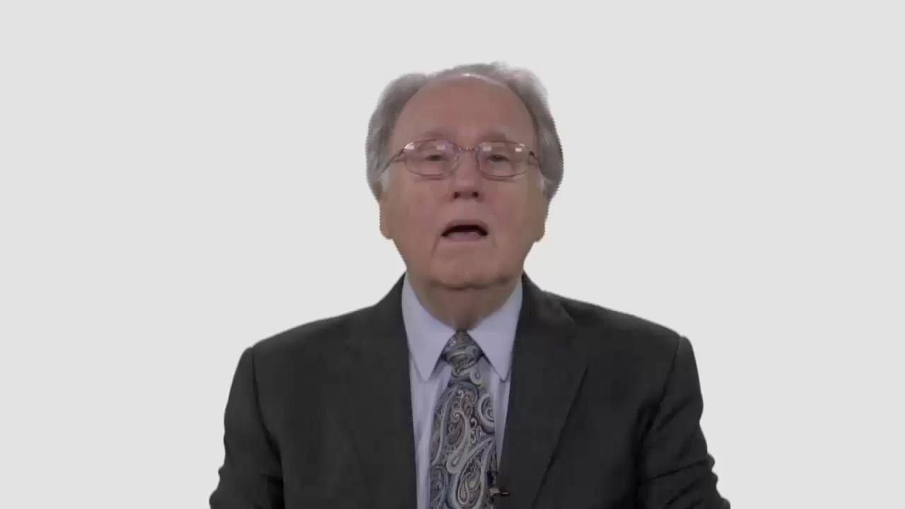

Slide 4
Have Your Say.
Do you think we can ever
justify direct involvement
in military action?

Slide 5
Conversation Builders.
What are some of the moral
issues that young people may face
in volunteering for military service?

Slide 6
Conversation Builders.
Are education, career, or even an escape from poverty legitimate considerations in weighing the moral implications of military service?

Slide 7
Discussion Questions.
In a time of war, don’t
Adventists have a duty
to support their nation?

Slide 8
Discussion Questions.
Is it possible for a congregation
to affirm the courage or sacrifice
of church members who serve in
the military without endorsing
their decisions to become part of
the military machine?

Slide 9
What Now?
Has the Adventist Church
generally done a good or poor
job of explaining its position
on noncombatancy?

Slide 10
What Now?
What are some practical ways
that your local church could
provide better guidance to
young people on this issue?

